Slide 1

PRESENTATION BY DATABUFFS
Team members:
1.Koushik Chakraborty
2.Manish Kumar

Slide 2
Lets go straight to our objective!!!
We have been given a dataset for the sales of Walmart, and we need to find the strategies and measures needed to make their sales as high as Tesla’s rockets…………
However, the question is can we make their sales increase???

Slide 3

*Walmart’s
sales
YES!!!!!
(we have to …..there is no other choice ☹ )

Slide 4

Now…what do we infer from the data???
First of all, let us see how many data points and features we have been given by Walmart to help them increase their sales:
In the given plot, we have :
1 . 6435 data points(represented by rows)
2 . 8 features( represented by the columns)

Slide 5
A description of the features that we need to consider :
So, here we have been given 8 features:
1. Store : The store number that sells
2. Date : Week of the sales
3. Weekly Sales : Sales for the given store
4. Holiday Flag : If week is a special holiday week
5. Temperature : Temperature on sales day
6. Fuel Price : Cost of fuel in the region of store
7. CPI : Customer price index
8. Unemployment : Prevailing unemployment rate in percentage

Slide 6
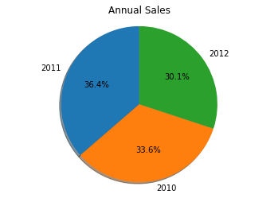
Sales for the given years in dataset
In the data set, we have data for the sales of 3 years:
2010 and 2011 and 2012
The sales for the years 2010,2011 and 2012 are as shown:
Sales percentage for the given years:
1.2010 -> 33.6 % ( 2160 )
2.2011 -> 36.4 % ( 2340 )
3. 2012 -> 30.1 % ( 1935 )

Slide 7
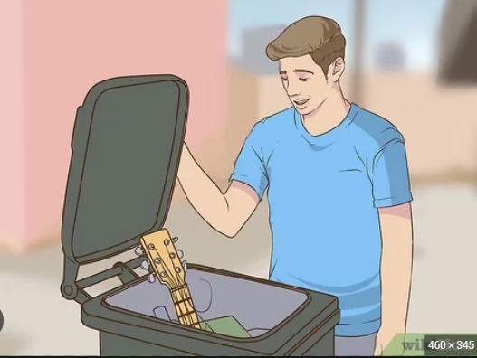
The Most important part we are going to do is checking for outliers in the data set we are checking by making box plots for the features:
WHY DO WE NEED TO MAKE BOX PLOTS FOR THE FEATURES?
We make box plots for the features to check if there are any values which are very less frequent and can be neglected and this are called our outliers. These data points if not removed can create bad data which does not help us in proper analysis.
Less frequent data

Slide 8
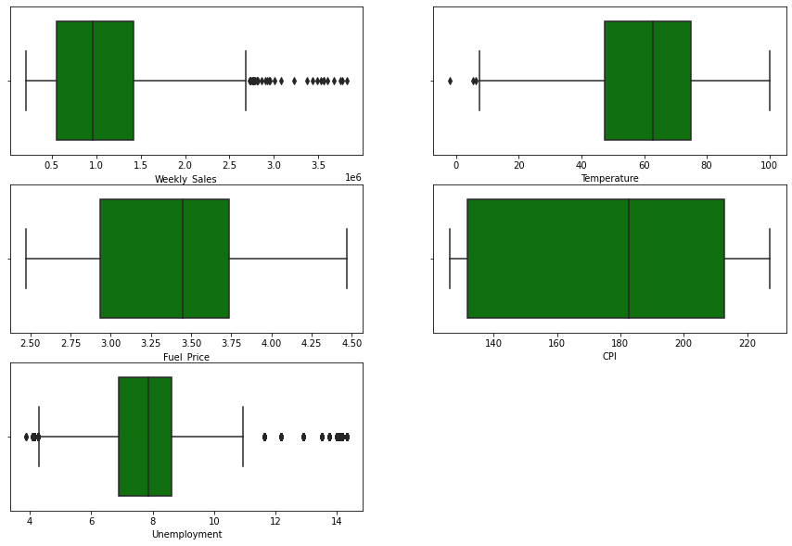
The graphs before removing the outliers:
This is annoying!!

Slide 9
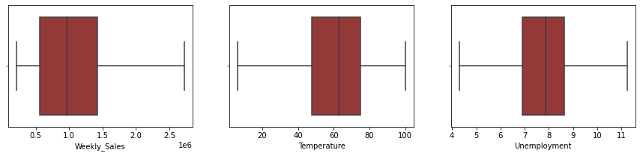

The graphs after removing the outliers:
Makes our data better!!

Slide 10
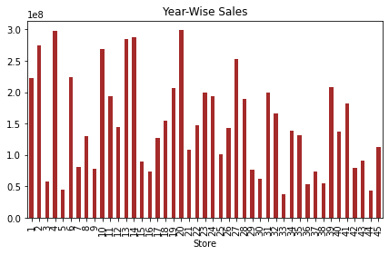
Now, let us look at the sales by the individual shops of Walmart…….

Slide 11
SO WHAT ARE THE THINGS THAT WE OBSERVE FROM THE PLOT IN THE PREVIOUS SLIDE ????
From the data set we see that shop number 4 and 20 are the highest selling shops from Walmart.
There are some other shops as well which are high selling shops as well ( like the shop number 2 , 10, 13, 14, 19 and 26 )

Slide 12
Now, let us look into the trends in weekly sales!!!!!
Firstly the trend change from 2010 ( January) to 2012( December).

Slide 13
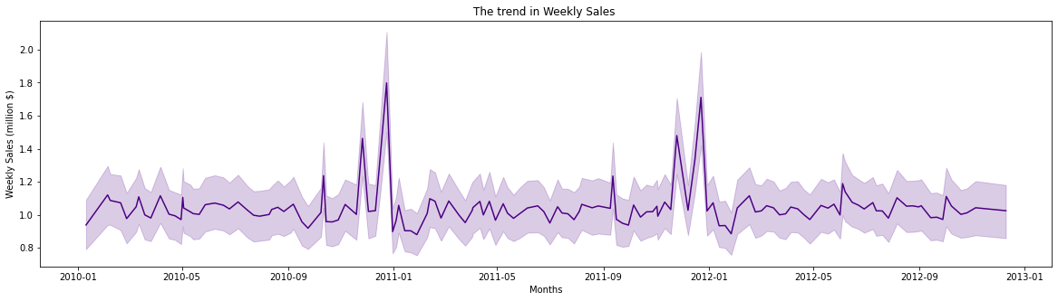
The trend in weekly sales from
January 2010 to December 2012
BOOM!!!!
BOOM!!!!

Slide 14
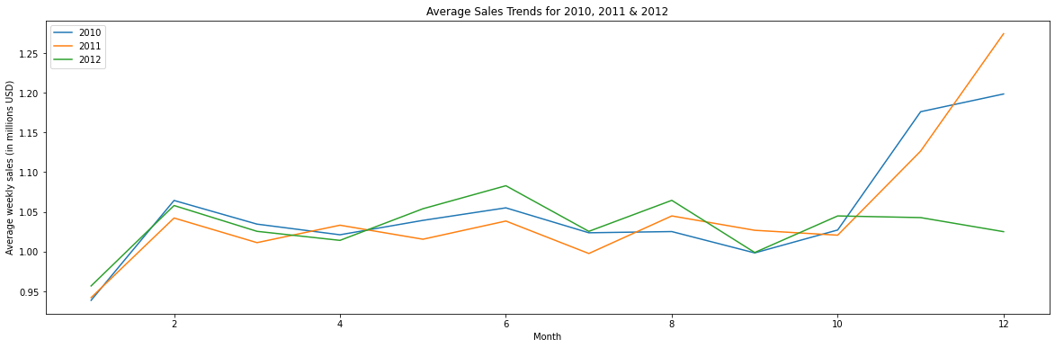
Average sales trends for 2010, 2011 and 2012
( month wise distribution)
BOOOOM!!!!!!
DO YOU SEE ANYTHING COMMON!!!!

Slide 15
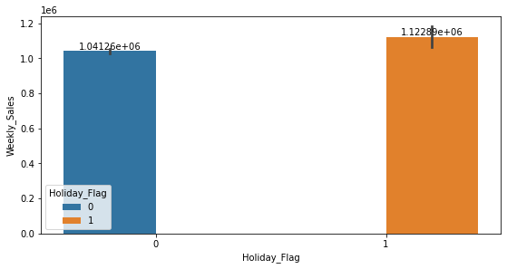
THE RELATION OF WEEKLY SALES WITH THE HOLIDAYS
HOLIDAYS === TARGET!!!!!

Slide 16
DO YOU REALISE ONE THING?????
In the month of late November, December, January and early February we have the FESTIVAL season in the United States and the other countries where Walmart has its sales. So, the HOLIDAY SEASON has been the most productive for the company.
So, obviously it needs to make the HOLIDAY SEASON as its target season In order to increase its sales.

Slide 17
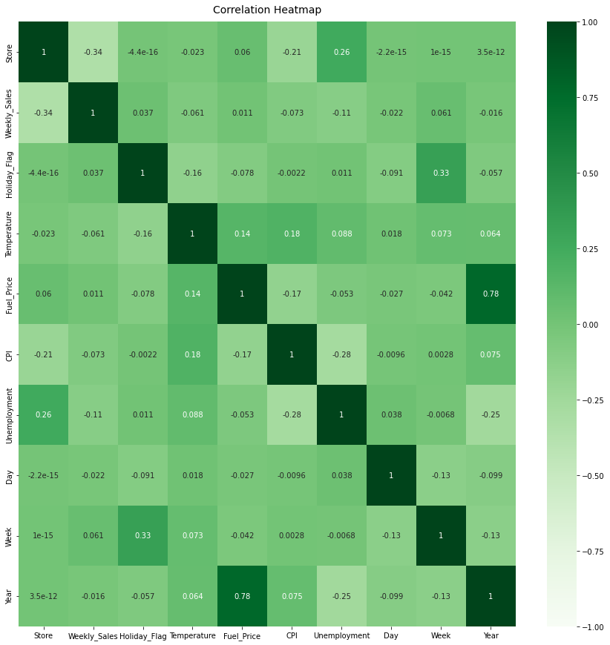
THE CORRELATION MATRIX BETWEEN THE VARIOUS FEATURES OF THE DATA SET

Slide 18
Now, you must be thinking…
“
Wait ..
What about the other features that you didn’t even care about till now like CPI, Temperature , Unemployment, etc ?
”
Well, do not worry we did analyse the relations of the weekly sales with those features as well….

Slide 19
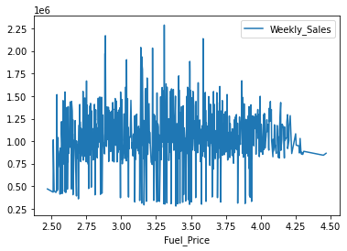
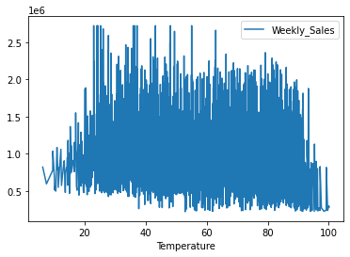
RELATION WITH THE FUEL PRICE
RELATION WITH THE TEMPERATURE

Slide 20
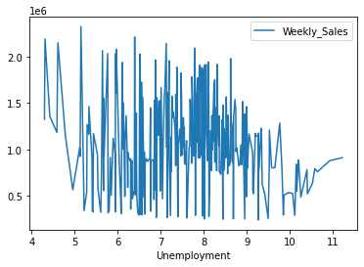
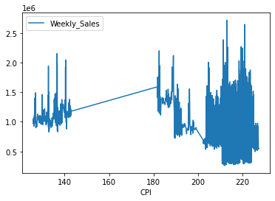
RELATION WITH UNEMPLOYMENT
RELATION WITH THE CONSUMER PRICE INDEX

Slide 21
WHAT DID WE SEE FROM THE PREVIOUS four GRAPHS???
We basically see that the weekly sales has a very poor relation with the CPI, Fuel Price, Unemployment and the Temperature
Also, it is pretty clear from the correlation matrix shown a few slides ago also shows the same…….

Slide 22
THE WAY TO SKYROCKET THEIR SALES…….
TARGET THE HOLIDAY SEASON IN ORDER TO INCREASE THE SALES, THAT IS THE MONTHS OF DECEMBER, JANUARY AND LATE NOVEMBER.
BRING FORWARD MORE CONSUMER-NECESSARY CONSUMER FRIENDLY PRODUCTS IN THE STORES THAT SELL THE MOST THAT ARE LIKE SHOPS 4, 20 AND THE OTHER SHOPS AS WELL.
FIND OUT WHICH PRODUCTS ARE THE ONES WHICH STAND OUT IN THE MOST SELLING SHOPS AND ADD THEM TO THE OTHER SHOPS AS WELL IN ORDER TO INCREASE THE SALES IN ALMOST ALL THE SHOPS THAT WE HAVE IN WALMART
DO NO HAMPER WITH THE CPI MUCH AS IF THE COST IS INCREASED TOO MUCH , THEN CUSTOMERS WOULD BE ATTRACTED LESS TO THE SHOPS AND IF IT IS DEDCREASED THEN THE PRODUCTS WOULD BE CONSUMED QUITE EARLIER THAN EXPECTED.

Slide 23
THANK YOU!!!! that’s all from our side…
Signing off,
DATABUFFS

